Slide 1
SUBJECT | LIFE SKILLS
GRADE | 2 YEAR 2
TERM | 1

Slide 2
TABLE OF CONTENT

Slide 3
LESSON PLAN CONTENT
WEEK 1-2 | Me and my community (places and people)
WEEK 3-4&5 | What do I need to live
WEEK 5-7&8 | Senses

Slide 4
LESSON OBJECTIVES

Slide 5
ASSESSMENT GOALS
ME AND MY COMMUNITY
• Discuss and explain how communities can work together
WHAT DO I NEED TO LIVE
• Understand why we have needs to live
ME AND OTHER PEOPLE
• Understand and list own role and roles of others
• Understand how to deal with conflict in a positive way
SENSES
• Explain and discuss how to care for eyes/ears/nose/mouth/skin

Slide 6

Theme:
Me and my community

Slide 7

Me and my community places and people

Slide 8

GROUP 1

Slide 9
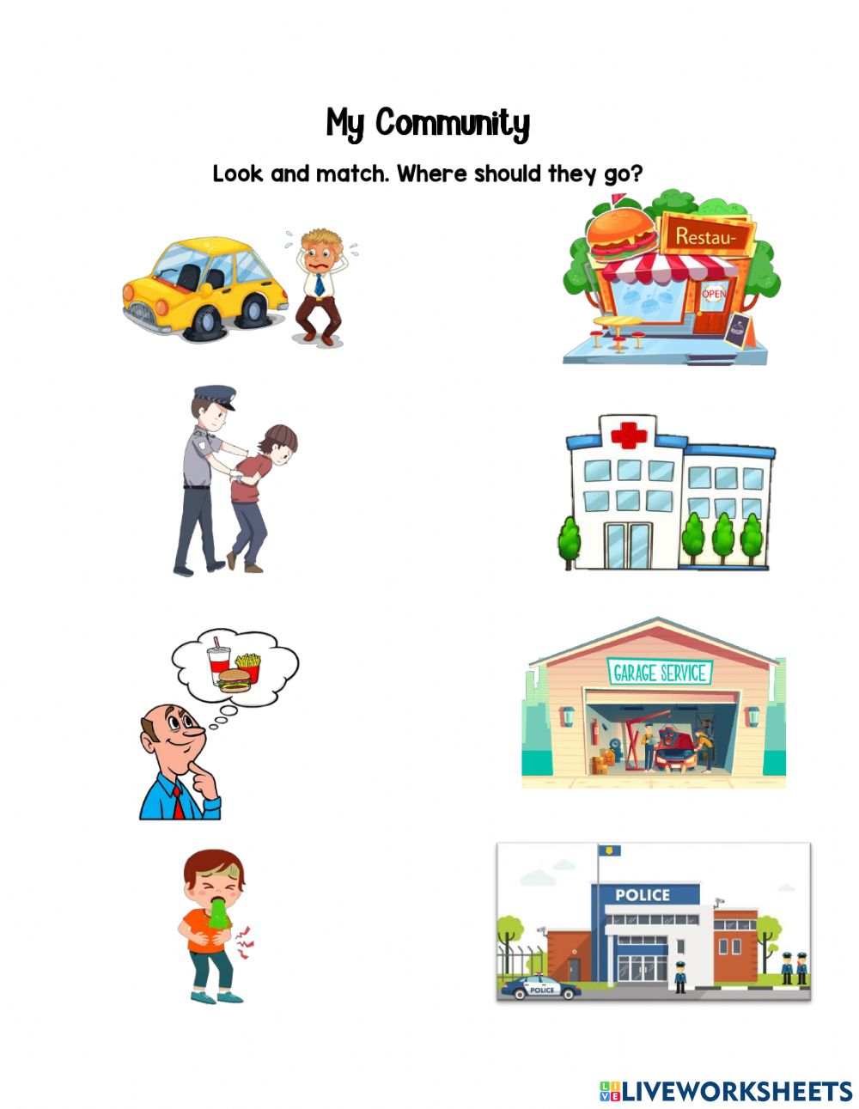
My community
Look and match, where should they go?

Slide 10
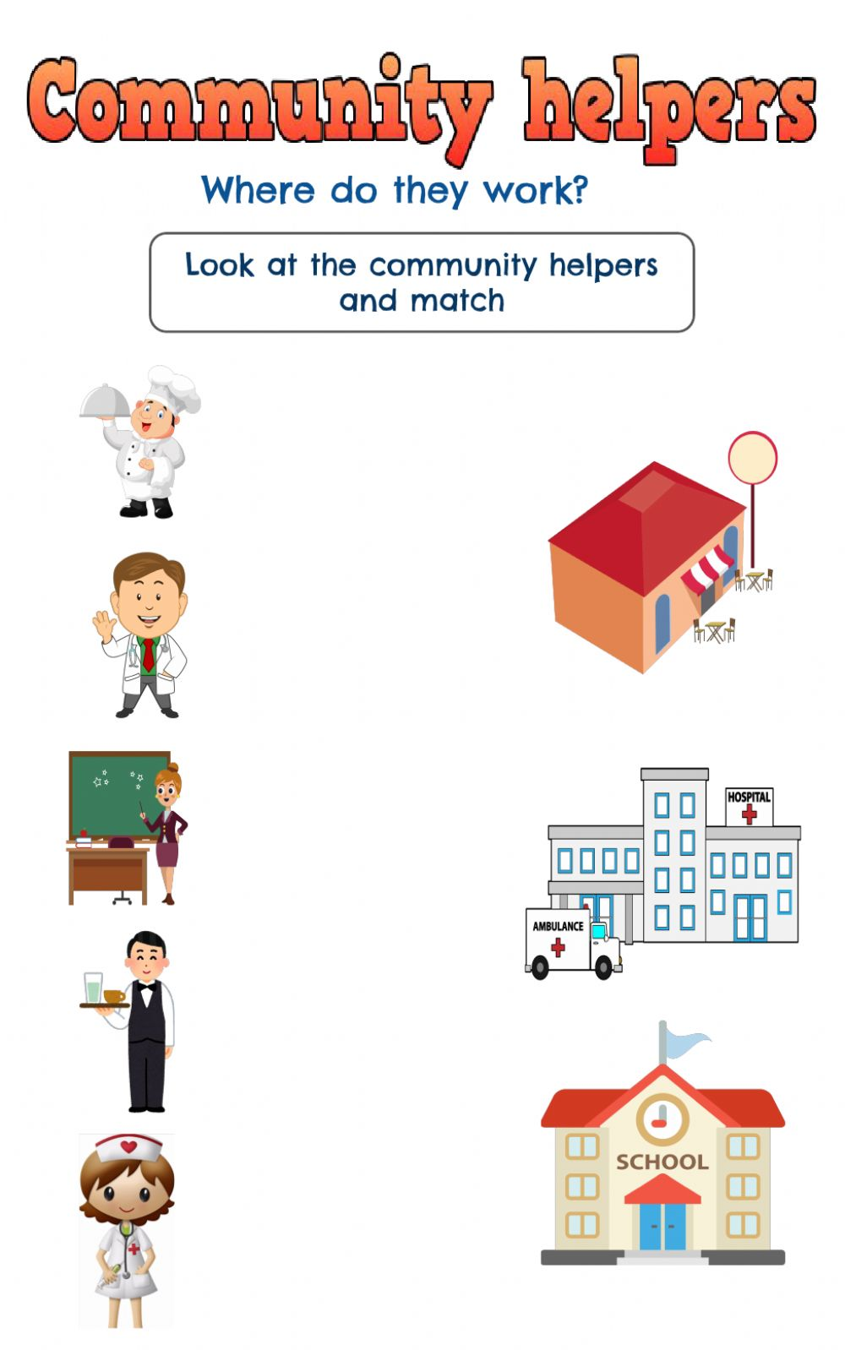
Where do they work?
Look at the community and match

Slide 11
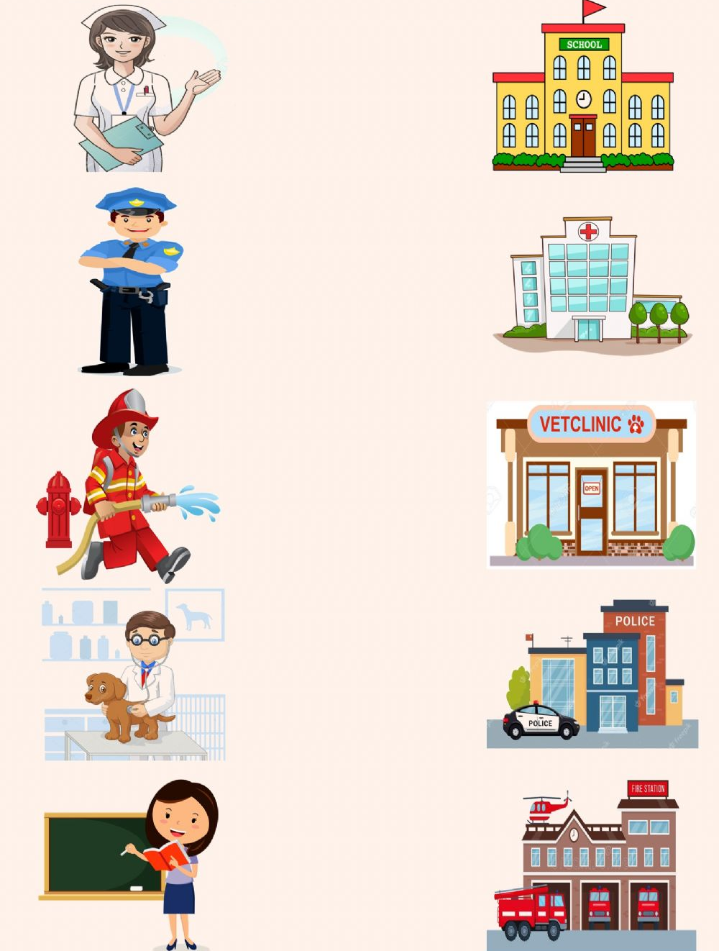
Draw a line matching the community helper with the building were he or she works.

Slide 12
GROUP 2

Slide 13
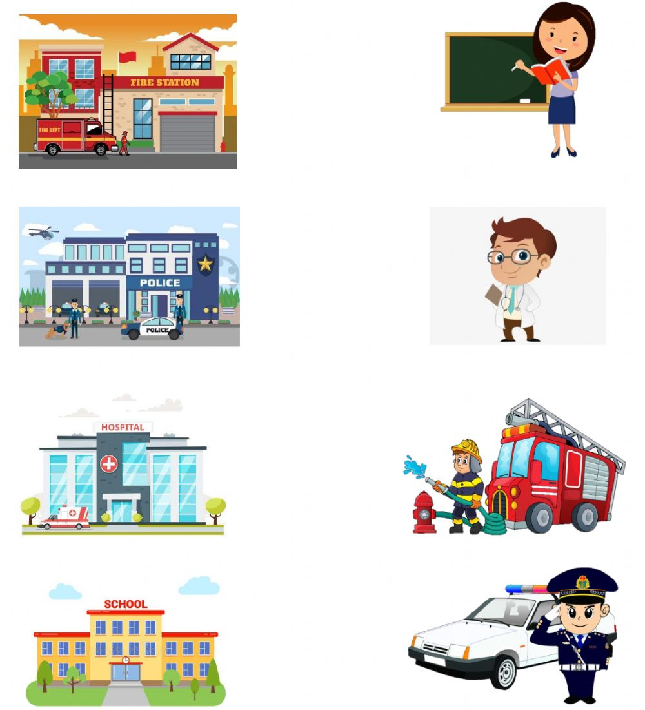
My community
Where do they work?

Slide 14
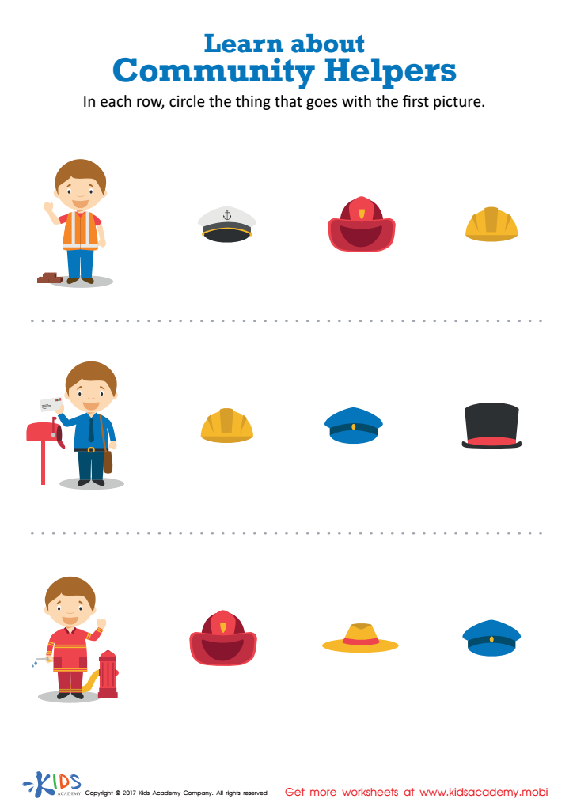
In each row, circle the thing that goes with the first picture.

Slide 15
GROUP 3

Slide 16
Draw your favourite place in your community and state why it is your favourite

Slide 17
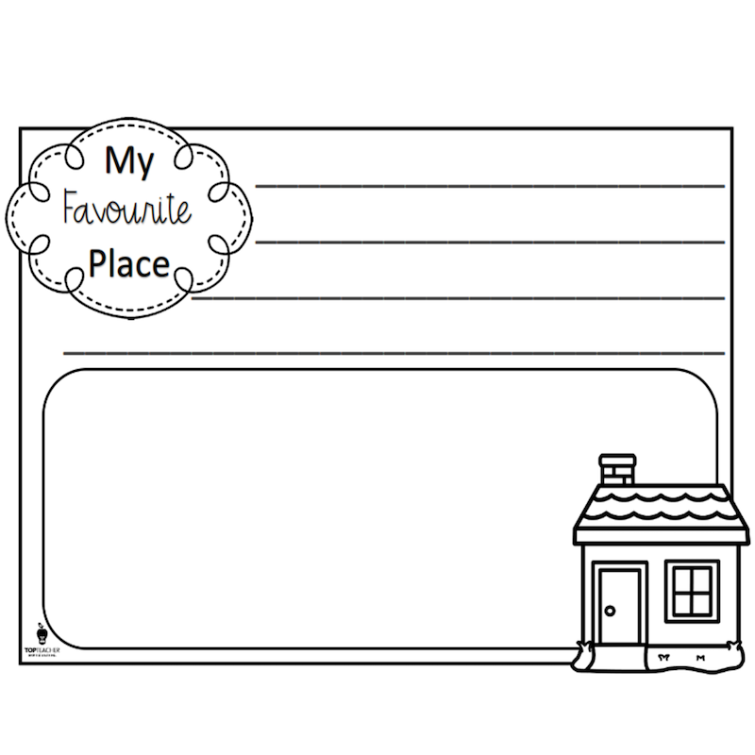
Draw your favourite place that is around your community

Slide 18
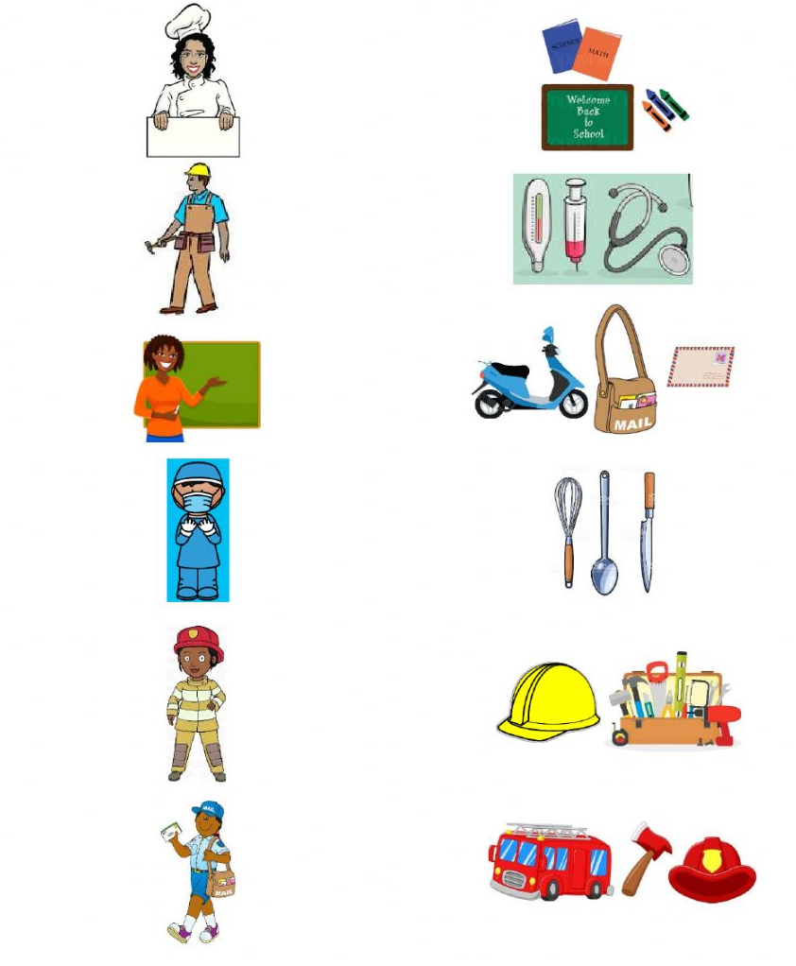
Look at the pictures. Draw a line to match the community helper with their tools.

Slide 19
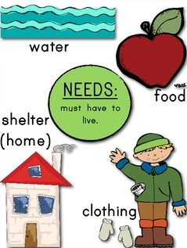
Theme
What do I need to live?

Slide 20
Group 1

Slide 21

Colour in the picture below

Slide 22
Group 2

Slide 23
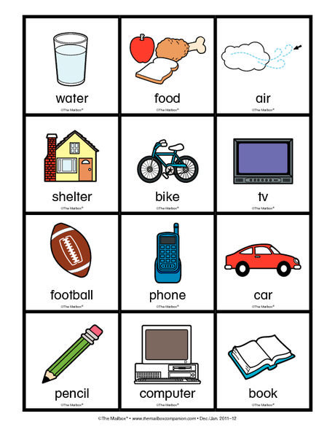
Discuss the picture below

Slide 24
Group 3

Slide 25
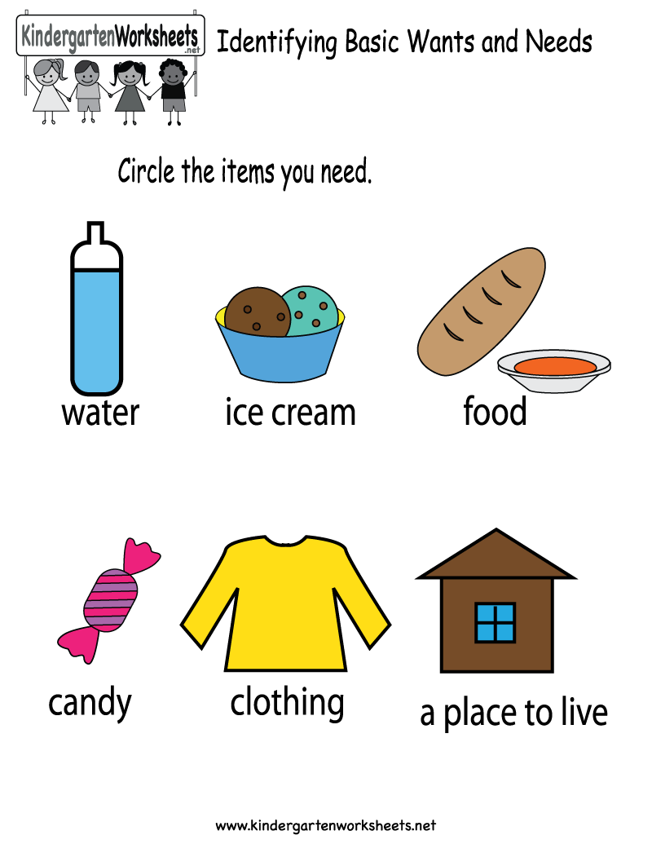
Circle the items that we need to survive

Slide 26

What do I need to live?

Slide 27
GROUP 1

Slide 28
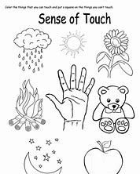
Colour in the picture

Slide 29
Colour in the picture that people need to live

Slide 30
Discuss the picture below

Slide 31
GROUP 2

Slide 32
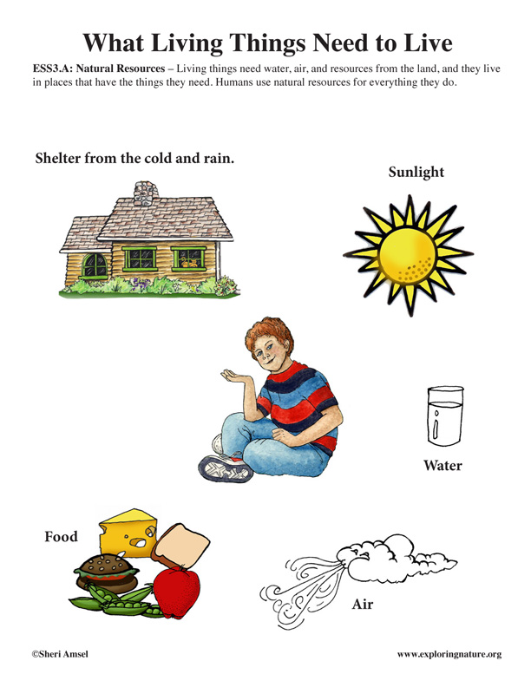
DISCUSS THE PICTURE BELOW

Slide 33
GROUP 3

Slide 34
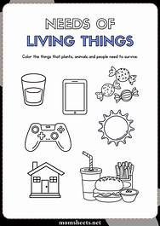
Circle the items that we need to survive

Slide 35

senses

Slide 36
Group 1

Slide 37
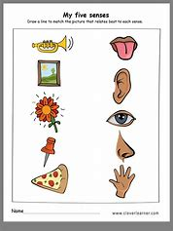
Match the pictures correctly

Slide 38
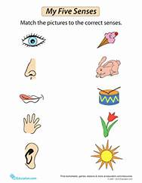
Match the picture to the correct senses

Slide 39
Group 2

Slide 40
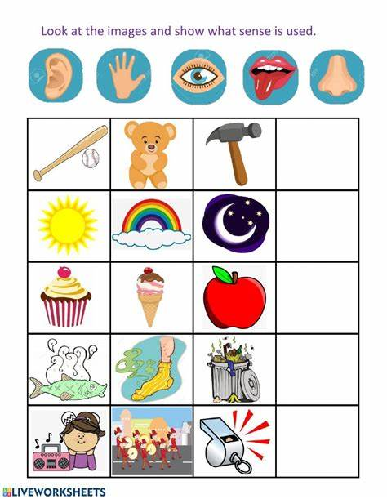

Slide 41
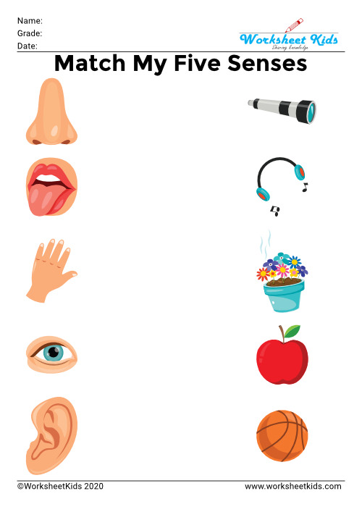
Match the following

Slide 42
Group 3

Slide 43
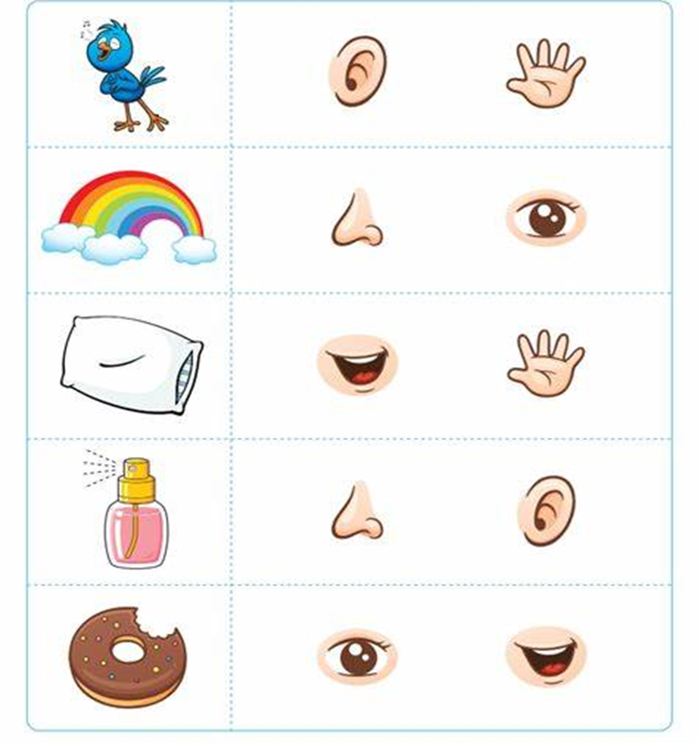
Look at the picture on the left then draw a circle around the sense that best matches the picture

Slide 44
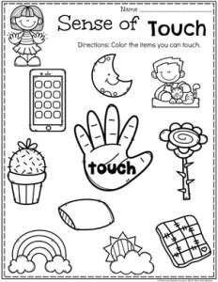
Colour the pictures you can touch

Slide 45
Reference list
Chaote, J.S. & Rakes, T.A. 2004.Recognizing Words as Tools for Reading Comprehension.In J.S.Chaote(Ed.).Successful Inclusive Teaching: Proven Ways to Detect and Correct Special Needs. Boston: Pearson.
Cohen, V.L. & Cohen, J.L. 2008. Literacy for Children in an Information Age: Teaching Reading, Writing and Thinking. Canada: Thomson Wadsworth.
Department of Education (DoE). 1997. Curriculum 2005 (C2005). Lifelong Learning for the 21stCentury.Pretoria: Department of Education.
Dole, J.A., Duffy, G.G., Roehler, L. & Pearson, P.D. 1999.Moving from the Old to the New: Research on Reading Comprehension Instruction, Review of Educational Research, 61:239-264.

